Slide 1
Project title
8x8 LED Matrix Scrolling Display with Arduino Control
Presented By:
Yogesh Kumar Chauhan 510617058
Nishant Bansal 510617062
Hariom Gupta 510617063
Ritik Raj 510617064
Kapil Agarwal 510617067
Jitin Chandolia 510617078

Slide 2
INTRODUCTION
As written in the title this project contains a matrix of 64 LEDs to which we are giving inputs according to our pattern of data to show.
We have used a shift register and Arduino to give proper inputs to the matrix.
ThIs matrix can be used at many places like:
‘For conveying some message to people around it’.
‘For showing routes and destinations on buses’.

Slide 3
Components used :
LED Lights
Arduino UNO
Shift Registor (SN74HC595N IC)
Resistors
Multimeter
Jumper Wires
Soldering Iron

Slide 4
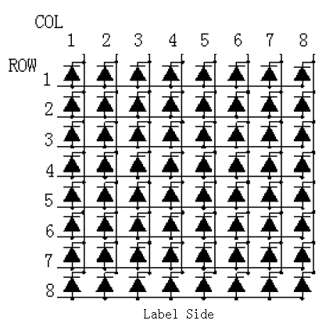
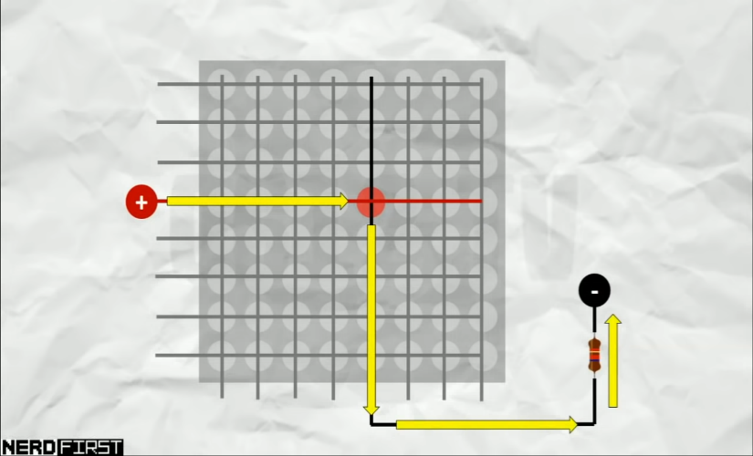
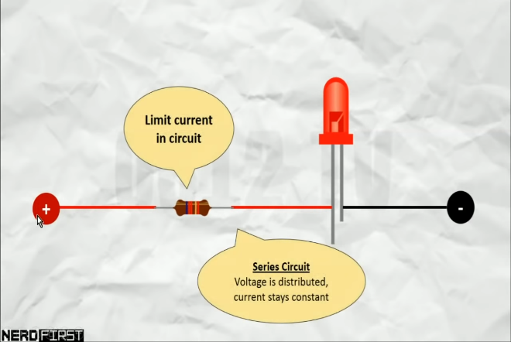

8x8 LED MATRIX
Construction
How to light up any particular LED in matrix ?
Need of resistance.
Where the problem arise?
Scaning.

Slide 5
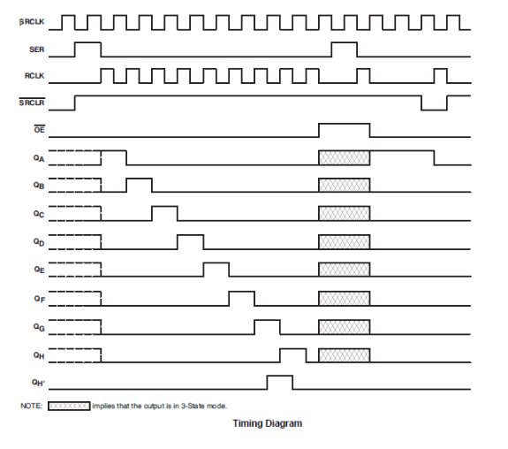
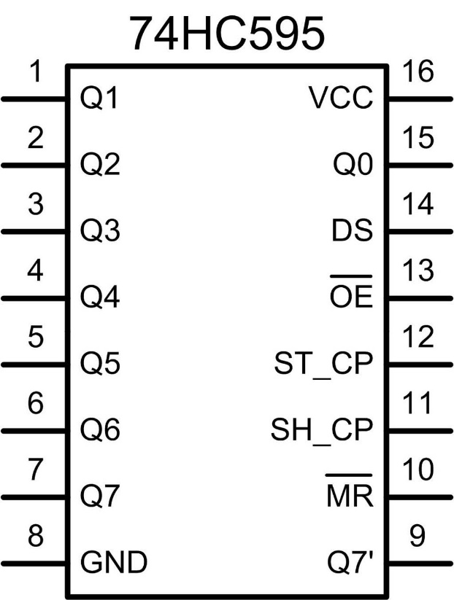
SIPO Shift Register IC(SN74HC595N)
Reduces the requirement of pins needed to connect LEDs to the microcontroller.
It contains two registers – ‘Shift Register’ and ‘Storage Register’ embedded in it.
Pin diagram of IC.
Working of the IC if input given to it is ‘11111111’ serially.
Timing diagram of SIPO Shift Register.

Slide 6
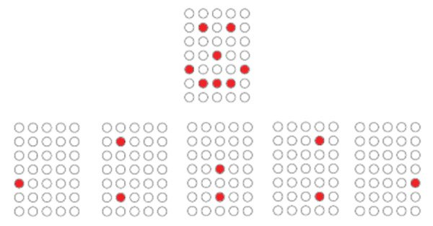
Multiplexing technique
What is multiplexing technique?
Why do we use it?

Slide 7
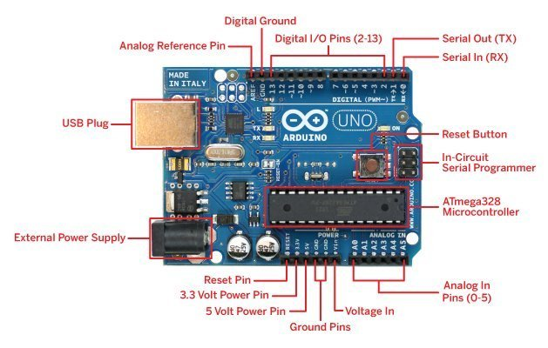
Arduino UNO(UNO R3)

Slide 8
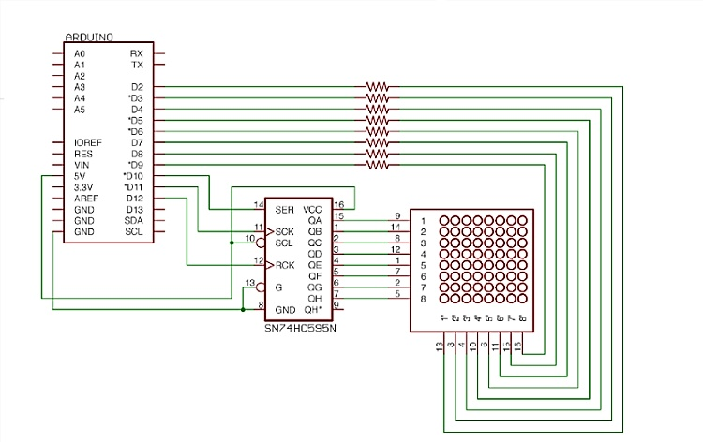
Circuit Diagram

Slide 9
Sample Arduino Code (For static characters):
byte character[3][8]={{B00001110,//Character to be written
B00000100,
B00000100,
B00000100,
B00000100,
B01000100,
B00100100,
B00011100},
{B10000001,//Character to be written
B01000010,
B00100100,
B00011000,
B00001000,
B00001000,
B00001000,
B00001000},
{B01111110,
B00000010,
B00000100,
B00001000,
B00010000,
B00100000,
B01000000,
B01111110}};

Slide 10
byte column_pin[8]={ 6, 7, 8, 9, 10, 11, 12, 13};
#define SER_PIN 3
#define SCK_PIN 5
#define RCK_PIN 4}
void setup()
{
// Turn everything to low
for(int i=0; i<8; i++) {
pinMode(column_pin[i],OUTPUT);
}
pinMode(SER_PIN, OUTPUT);
pinMode(SCK_PIN, OUTPUT);
pinMode(RCK_PIN, OUTPUT);
Serial.begin(9600);
}

Slide 11
void loop()
{
// iterate each row
int rowbits = 0x80;
static int g=0;
for(int row=0; row<8; row++)
{
for(int k=0; k<8; k++)
digitalWrite(column_pin[k],HIGH); // Cleanup cols
writerow(rowbits); // prepare to write the row
for(int col=0; col<8; col++)
{
digitalWrite(column_pin[7-col], character[(g/100)%3][row] & 1 << col ? LOW : HIGH);
}
delay(1);
writerow(0);
rowbits >>= 1;
}
g=g+1;
}

Slide 12
void writerow(byte data)
{
digitalWrite(RCK_PIN, LOW);
shiftOut(SER_PIN, SCK_PIN, LSBFIRST, data);
digitalWrite(RCK_PIN, HIGH);
}

Slide 13
Sample Arduino Code (Scrolling characters):
byte characters[5][8] = {
// H
{B10000001,
B10000001,
B10000001,
B11111111,
B10000001,
B10000001,
B10000001,
B10000001},
// E
{B11111111,
B10000000,
B10000000,
B11111110,
B10000000,
B10000000,
B10000000,
B11111111},

Slide 14
// L
{B10000000,
B10000000,
B10000000,
B10000000,
B10000000,
B10000000,
B10000000,
B11111111},
// L (repeated)
{B10000000,
B10000000,
B10000000,
B10000000,
B10000000,
B10000000,
B10000000,
B11111111},

Slide 15
// O
{B01111110,
B10000001,
B10000001,
B10000001,
B10000001,
B10000001,
B10000001,
B01111110}};
byte column_pin[8] = { 6, 7, 8, 9, 10, 11, 12, 13 };
#define SER_PIN 3
#define SCK_PIN 5
#define RCK_PIN 4

Slide 16
void setup()
{ // Turn everything to low
for(int i = 0; i < 8; i++) {
pinMode(column_pin[i], OUTPUT);
}
pinMode(SER_PIN, OUTPUT);
pinMode(SCK_PIN, OUTPUT);
pinMode(RCK_PIN, OUTPUT);
Serial.begin(9600);
}
void loop() {
static int position = 0; // Position of the scrolling text
for(int i = 0; i < 8; i++) {
displayCharacter(position, i); delay(2); // Adjust speed of scrolling
}
position++; // Move to the next column
if (position >= 8 * 5) { // Reset position after complete scroll
position = 0;
}
}

Slide 17
void displayCharacter(int position, int row) {
int charIndex = position / 8; // Determine which character to display
int columnShift = position % 8; // Determine the column shift
for(int col = 0; col < 8; col++) {
// Write the shifted character to the matrix
int characterColumn = (characters[charIndex][row] >> columnShift) & 0x01; digitalWrite(column_pin[7 - col], characterColumn ? LOW : HIGH);
}
writerow(0x80 >> row); // Write the row data
}
void writerow(byte data) {
digitalWrite(RCK_PIN, LOW);
shiftOut(SER_PIN, SCK_PIN, LSBFIRST, data);
digitalWrite(RCK_PIN, HIGH);
}

Slide 18



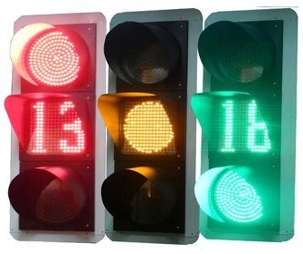
Application:
For Displaying Information
In Public Transportation Vehicles
In Large Displays
In Traffic Signalling

Slide 19
Advantages:
Used in advertisement
Difficult to damage with external shock
Relatively long useful life
Small and easily populated onto PCBs
Good efficiency
Disadvantages:
Colour uniformity
Limitation on character size
Output has not high resolution
Pins can bend easily
Print quality

Slide 20
THANK YOU.

